Slide 1
Thesis Revision Revised Title: Refining Optimization Methods for Training Machine Learning Models: A Case Study in Robotic Surgical Procedures
Boabang Francis

Slide 2
Remove Tactile Internet Content from the Introduction Section
Thank you for drawing my attention to this issue:
I have revised the introduction to include information on machine learning and optimization. Additionally, I introduce the challenges of implementing optimization techniques in contemporary machine learning approaches. Lastly, I have discuss the exploration the application of optimization-driven machine learning models in robotic surgery and their challenges.

Slide 3
Proposed Models Efficiency
Chapter 3: Thank you for your question:
Incremental low rank matrix factorization Gaussian process regression is efficient because the incremental eigendecompositon used for computing the covariance matrix allowed for faster computing and updating the model with improved accuracy.
Chapter 4: Thank you for bringing my attention to this issue.
Faster convergence of the proposed stochastic gradient descent algorithm means we can achieved convergence faster with improved accuracy which makes our model very efficient.

Slide 4

Update the Notation Table
Thank you for your comment! I have updated the notation table to include variables that were missing in the previous version of the thesis. For instance, $k$ now represents the number of states.

Slide 5
Proof of Convergence and Recovery Rates
The proof of convergence for the proposed stochastic gradient descent algorithm can be found in Tables 2.2 and 2.3 showing best convergence rate.
The recovery rate of the proposed incremental low-rank matrix factorization scheme is detailed in Table 2.1 showing the best recovery rate.

Slide 6
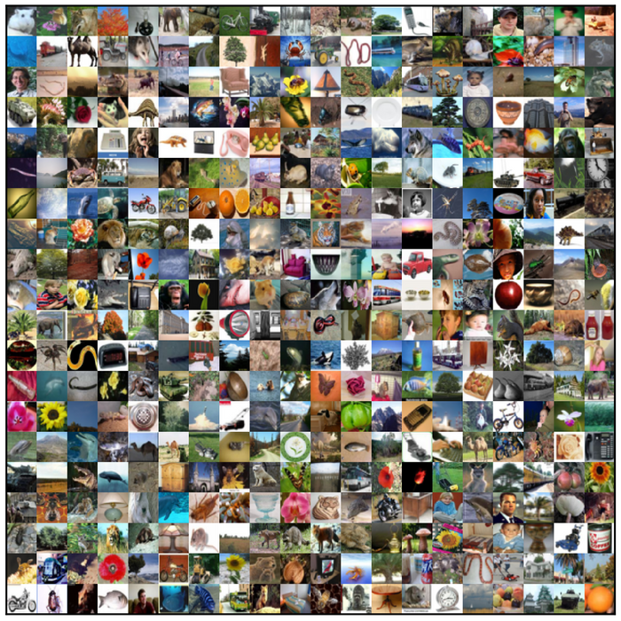
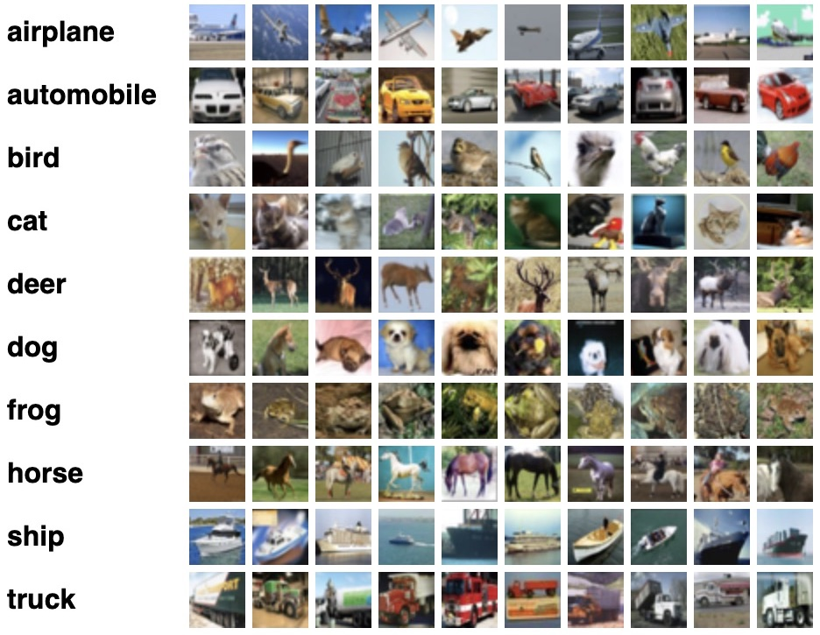
CIFAR-100 Image Dataset
500 training images per class
100 testing images per class
100 classes
20 Super classes with 5 Subclasses]

Slide 7
CASE A: Initial Experiment in the Thesis Chapter 4
Test data
Train data
Without data augmentation: Train/Test data

Slide 8
Preprocessing Step
I apply simple mean and standard deviation normalization, sample centering, horizontal flipping, and ZCA whitening to both the training and test datasets. Additionally, I perform random cropping on the training data. The dropout rate is set to 0.3. I used a batch size of 256 on WideResNet with depth set at 16 and width set at 4.

Slide 9
CASE B
Test data
Train data
With basic
augmentation: normalization,
horizontal flip, ZCA whitening
Heavy Augmentation with normalization, horizontal flip, ZCA whitening, horizontal flip, and
random cropping

Slide 10
I have updated the code to include WideResNet with data augmentation
https://github.com/boabangf21/Proposed_ASGD-Improved-Adam-and-Amsgrad-
WideResnet with Data Augmentation_Main_run.py
Wideresnet.py

Slide 11
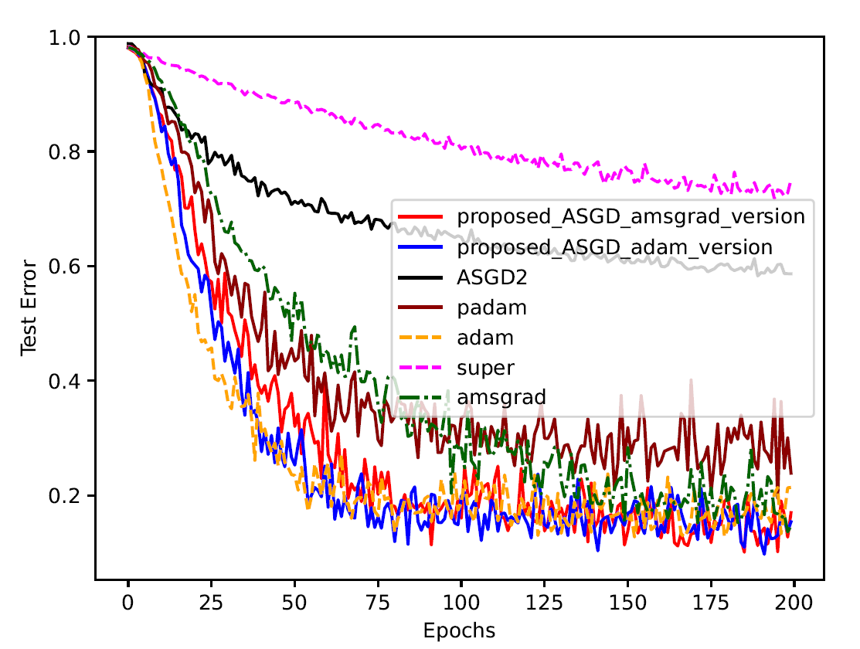
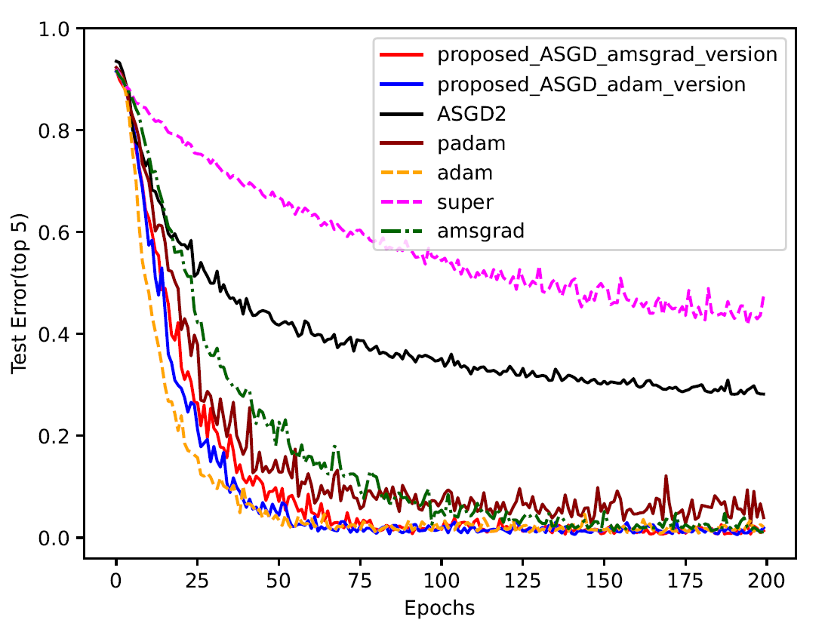
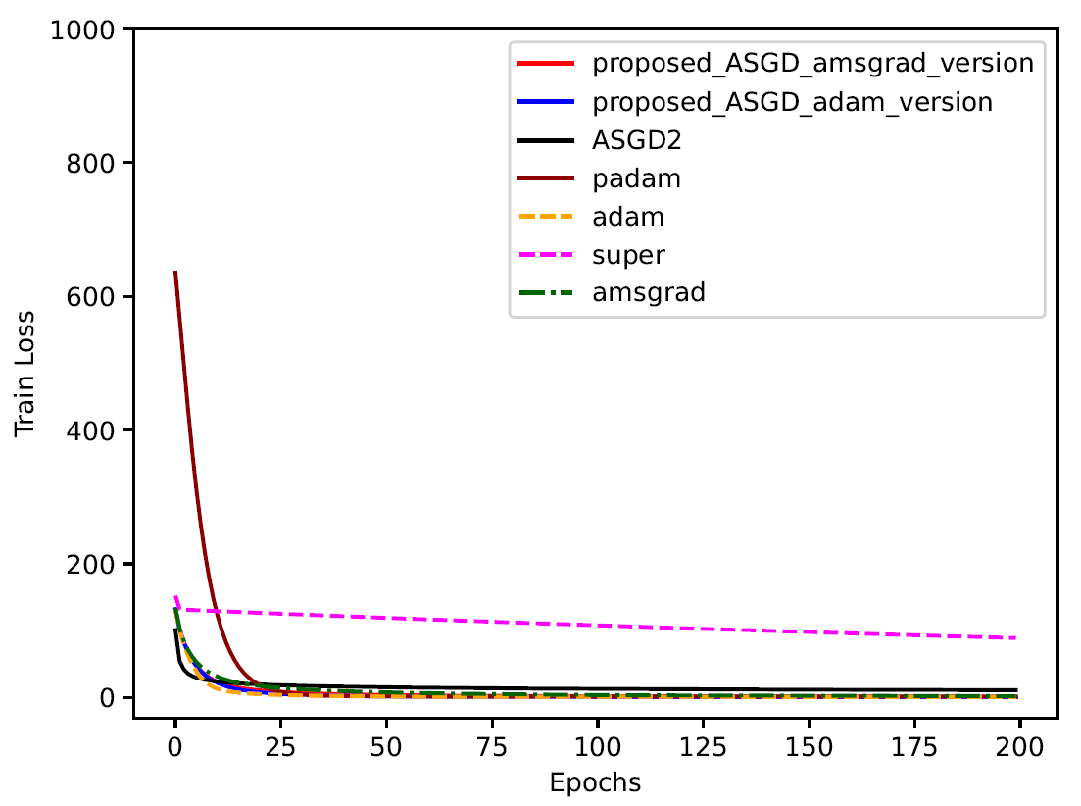
Results (WideResNet with Data Augmentation and Batch Size of 256-page 72-74)

Slide 12
New Table: CIFAR-100 with Data Augmentation and Batch Size of 256-pages 74 -76
Optimizer | ADAM | PADAM | ASGD2 | AMSGRAD | SUPERADAM | Improved Adam | Improved Amsgrad
Top-1 | 78.97 | 76.11 | 41.13 | 85.31 | 24.93 | 84.59 | 83.00
Top-5 | 97.86 | 96.04 | 71.80 | 98.84 | 52.47 | 98.04 | 98.62
The notable improvement across all models except SuperAdam can be attributed to the data augmentation techniques implemented to enhance performance. Additionally, the impact of the optimizers was diminished by the effects of data augmentation and the introduction of dropout. The improved Adam optimizer, used with the WideResNet model and data augmentation, demonstrated greater stability in the later stages of training compared to other models. However, the Amsgrad optimizer achieved the best final top-1 and top-5 accuracy, albeit with significant fluctuations in model performance. This variability can be linked to Amsgrad's inability to effectively address issues related to the base learning rate dilemma. SuperAdam struggled because the data augmentation increased the variability of the dataset, making it challenging for the algorithm to effectively reduce variance. Additionally, Superadam is most effective with rapidly decaying gradient architectures.

Slide 13
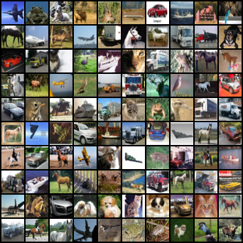
Add Additional Dataset CIFAR 10
The CIFAR-10 dataset is a widely used benchmark in machine learning and computer vision. It consists of 60,000 32x32 color images divided into 10 classes, with each class containing 6,000 images. The dataset is split into 50,000 training images and 10,000 test images.

Slide 14
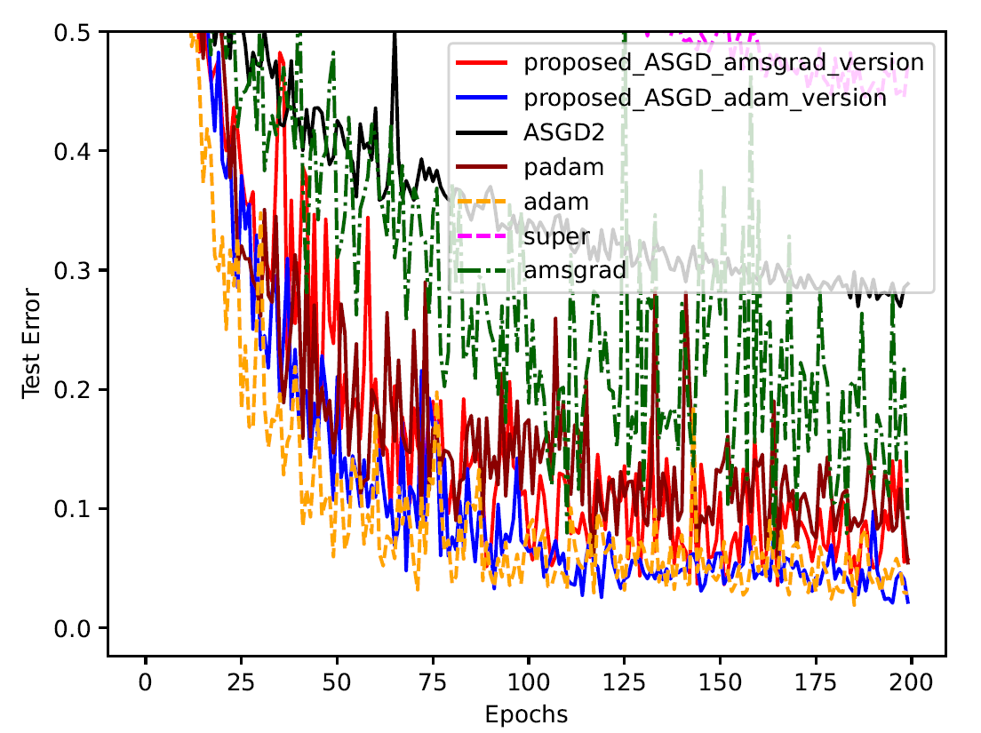
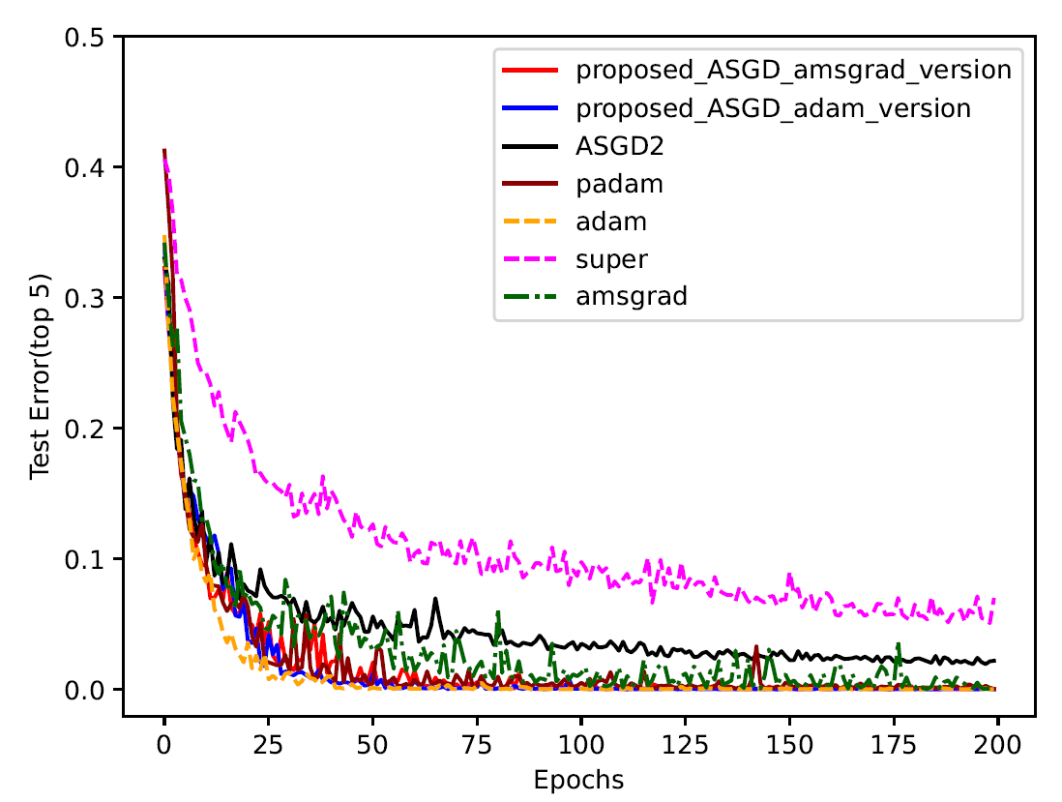
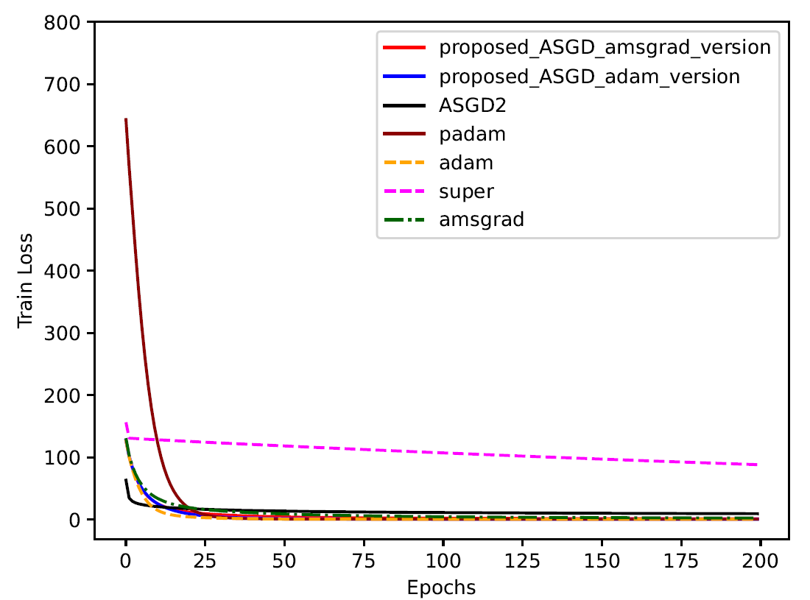
Results: CIFAR 10 : WideResNet with Data Augmentation and Batch Size of 256- pages 74-76

Slide 15
CIFAR-10 with Data Augmentation and Batch Size of 256-pages 74-76
Optimizer | ADAM | PADAM | ASGD2 | AMSGRAD | SUPERADAM | Improved Adam | Improved Amsgrad
Top-1 | 97.09 | 94.54 | 71.14 | 90.88 | 52.70 | 97.83 | 94.23
Top-5 | 99.98 | 99.94 | 97.80 | 99.80 | 92.98 | 99.99 | 99.98
The significant improvement observed across all models except SuperAdam is largely due to the data augmentation techniques applied to enhance performance on the CIFAR-10 dataset. Furthermore, the influence of the optimizers remained significant, even with the effects of data augmentation and the introduction of dropout in the WideResNet model. The proposed improved Adam optimizer surpassed state-of-the-art optimizers in both stability and testing performance. This achievement can be linked to the strategy of dividing coordinate values and assigning different base learning rates, effectively addressing the small learning rate dilemma. Additionally, optimizers like improved AMSGrad, AMSGrad, and Padam, which utilize the maximum second-order momentum matrix, struggled to perform effectively in WideResNet. This is primarily due to the slow gradient decay, which diminishes the utility of the maximum second-order momentum matrix. Similarly, ASGD2 and SUPERADAM underperformed because they did not adequately tackle the issue of small learning rates. Furthermore, data augmentation increased the variance of the dataset, resulting in poor performance from SuperAdam.

Slide 16


